Slide 1


Bidirectional Encoder Representations from Transformers (BERT)
GwangWoo Kim
August 12, 2021

Slide 2
Contents
Introduction to Natural Language Processing (NLP)
Bidirectional Encoder Representations from Transformers (BERT)
Input Representation
Transformer Architecture
Pre-training BERT
Fine-tuning BERT
References

Slide 3

1. Introduction to NLP
Natural Language
English, 한국어
Language
Constructed Language
Programming language,
Esperanto

Slide 4
2. BERT
KAIST
[ vector ]

Slide 5
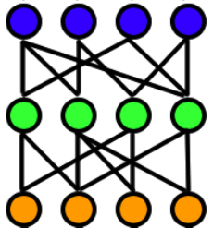
2. BERT
KAIST
[ vector ]
Word2Vec, FastText, etc.

Slide 6
2. BERT
Can I use …
[the same vector]
The use of …
Word2Vec, FastText, etc.

Slide 7
2. BERT
Can I use …
[different vectors]
The use of …
Contextual word embedding

Slide 8


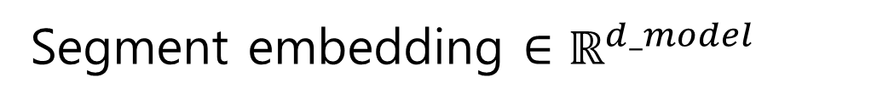

2. BERT
Welcome to KAIST
Welcome / to / KAIST
[CLS] / Welcome / to / KAIST / [SEP]
Word embedding $∈ℝ^{d_model}$
Position embedding $∈ℝ^{d_model}$
Segment embedding $∈ℝ^{d_model}$
Input representation = sum of these vectors
Output = Transformers(Input)

Slide 9
3. Input (Tokenization)
data
vocab
low x5
newest x6
l, o, w, e, r, n, w, s, t, i, d
lower x2
widest x3

Slide 10
3. Input (Tokenization)
data
vocab
low x5
newest x6
l, o, w, e, r, n, w, s, t, i, d
es
lower x2
widest x3

Slide 11
3. Input (Tokenization)
data
vocab
low x5
new(es)t x6
l, o, w, e, r, n, w, s, t, i, d
es, est
lower x2
wid(es)t x3

Slide 12
3. Input (Tokenization)
data
vocab
low x5
newest x6
l, o, w, e, r, n, w, s, t, i, d
es, est, lo
lower x2
widest x3

Slide 13
3. Input (Tokenization)
data
vocab
low x5
newest x6
l, o, w, e, r, n, w, s, t, i, d, es, est, lo, low, ne, new, newest, wi, wid, widest
lower x2
widest x3

Slide 14
3. Input (Tokenization)
Algorithm (Byte Pair Encoding)
Input: training data, maximum iteration number, desired vocab size,
smallest rare frequency.
Output: vocab

Slide 15
3. Input (Word embedding)
l : 1
o : 2
w : 3
e : 4
r : 5
n : 6
w : 7
s : 8
t : 9
i : 10
d : 11
es : 12
est : 13
lo : 14
low : 15
ne : 16 new : 17 newest : 18 wi : 19
wid : 20
widest : 21
l, o, w, e, r, n, w, s, t, i, d, es, est, lo, low, ne, new, newest, wi, wid, widest

Slide 16
3. Input (Word embedding)
l : 1
o : 2
w : 3
e : 4
r : 5
n : 6
w : 7
s : 8
t : 9
i : 10
d : 11
es : 12
est : 13
lo : 14
low : 15
ne : 16 new : 17 newest : 18 wi : 19
wid : 20
widest : 21
low = [15]
lowest (low / est) = [15, 13]
dense = [11, 4, 6, 8, 4]
lowing (low / i / n / g?)
= [15, 10, 6, ?]

Slide 17
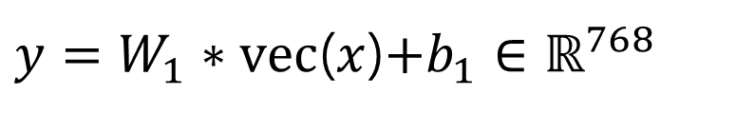
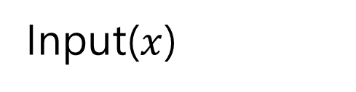
3. Input (Word embedding)
Input($x$)
low
lowest
$y=W_{1}∗vec$($x$)$+b_{1}∈ℝ^{768}$
dense
lowing

Slide 18
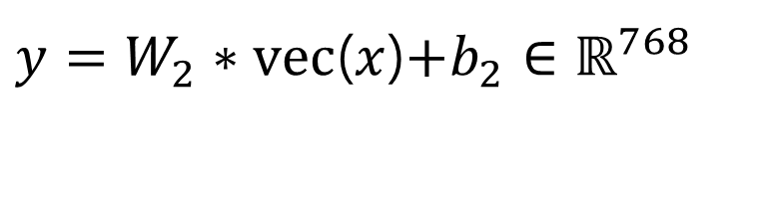
3. Input (Position embedding)
[CLS] / Welcome / to / KAIST / [SEP]
[CLS] = [0, 1, 2, 3, 4]
Welcome = [-1, 0, 1, 2, 3]
$y=W_{2}∗vec$($x$)$+b_{2}∈ℝ^{768}$
to = [-2, -1, 0, 1, 2]
KAIST = [-3, -2, -1, 0, 1]
[SEP] = [-4, -3, -2, -1, 0]

Slide 19

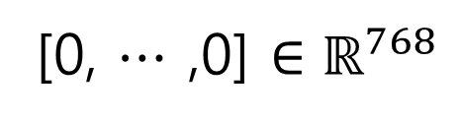

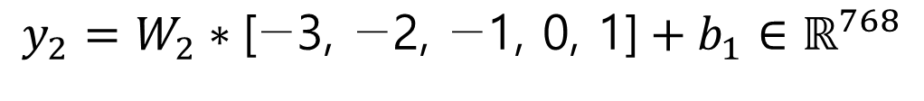
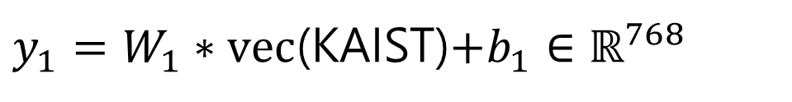

3. Input (Segment embedding)
[CLS] / Welcome / to / KAIST / [SEP] / Thank / you / [SEP]
[CLS] ~ [SEP] = [0, $⋯$ ,0] $∈ℝ^{768}$
Thank ~ [SEP] = [1, $⋯$ ,1] $∈ℝ^{768}$
$y_{1}=W_{1}∗vec$(KAIST)$+b_{1}∈ℝ^{768}$
$$y_{2}=W_{2}∗\text{[−3, −2, −1, 0, 1]}+b_{1}∈ℝ^{768}$$
Example: KAIST
[0, $⋯$ ,0] $∈ℝ^{768}$

Slide 20
4. Transformer Architecture
Key1
Value1
Query
Key2
Value2
Key3
Value3

Slide 21
4. Transformer Architecture
Key1
Value1
Query
Key2
Value2
Key3
Value3

Slide 22
4. Transformer Architecture
Query
Key1
Value1
Query
Key2
Value2
Query
Key3
Value3

Slide 23















4. Transformer Architecture
$$Q_{KAIST}$$
$$W^{Q}$$
$$=$$
$$∈ℝ^{768/num_heads}$$
$$×$$
KAIST
$$K_{KAIST}$$
$$×$$
$$W^{K}$$
$$=$$
$$∈ℝ^{768/num_heads}$$
$$×$$
$$V_{KAIST}$$
$$W^{V}$$
$$∈ℝ^{768/num_heads}$$
$$=$$

Slide 24

















4. Transformer Architecture
$$K_{Welcome}$$
$$V_{Welcome}$$
$$w_{1}$$
$$×$$
$$∙$$
$$Q_{KAIST}$$
$$K_{to}$$
$$V_{to}$$
$$∙$$
$$∈ℝ^{64}$$
Softmax
$$w_{2}$$
$$×$$
$$∙$$
$$K_{KAIST}$$
$$V_{KAIST}$$
$$w_{3}$$
$$×$$

Slide 25












4. Transformer Architecture
$$V_{Welcome}$$
$$w_{1}$$
$$×$$
$$Q_{KAIST}$$
$$V_{to}$$
$$A_{KAIST}$$
Softmax
$$w_{2}$$
$$+$$
$$×$$
$$V_{KAIST}$$
$$w_{3}$$
$$×$$

Slide 26






4. Transformer Architecture
Welcome
$$Q_{Welcome}$$
$$A_{Welcome}$$
Attention Value Matrix
to
$$Q_{to}$$
$$A_{to}$$
KAIST
$$Q_{KAIST}$$
$$A_{KAIST}$$

Slide 27

4. Transformer Architecture
Welcome
$$Q_{Welcome}$$
$$A_{Welcome}$$
Attention Value Matrix
to
$$Q_{to}$$
$$A_{to}$$
$$×12$$
KAIST
$$Q_{KAIST}$$
$$A_{KAIST}$$

Slide 28
4. Transformer Architecture

Slide 29




4. Transformer Architecture
$$∈ℝ^{len(seq)×786}$$
$$×W^{O}$$
$$=$$
Multi-head Attention Value Matrix
$$∈ℝ^{len(seq)×786}$$

Slide 30
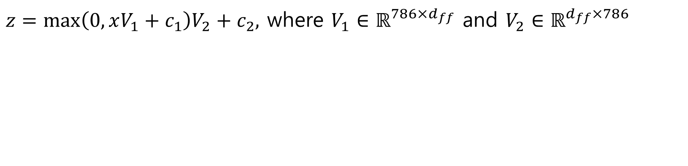


4. Transformer Architecture
$x=$ Multi-head Attention Value Matrix$∈ℝ^{len(seq)×786}$
$z=\max\left(0,xV_{1}+c_{1}\right)V_{2}+c_{2},$ where $V_{1}∈ℝ^{786×d_{ff}}$ and $V_{2}∈ℝ^{d_{ff}×786}$
Multi-heads
FFNN
$$ℝ^{len(seq)×786}$$
$$ℝ^{len(seq)×786}$$

Slide 31



4. Transformer Architecture
$$ℝ^{len(seq)×786}$$
$$L$$

Slide 32
4. Transformer Architecture
Welcome to KAIST
Welcome / to / KAIST
[CLS] / Welcome / to / KAIST / [SEP]
Word embedding $∈ℝ^{d_model}$
Position embedding $∈ℝ^{d_model}$
Segment embedding $∈ℝ^{d_model}$
Input representation = sum of these vectors
Output = Transformers(Input)

Slide 33

5. Pre-training BERT (Masking Method)
Welcome to KAIST
Randomly chosen token (15%)
Welcome / to / [MASK]
Welcome / to / BERT
Welcome / to / KAIST
Masking (80%)
Randomly replacing (10%)
Unchanging (10%)

Slide 34
5. Pre-training BERT (Masking Method)
Welcome / to / [MASK]
Welcome / to / BERT
Welcome / to / KAIST
Masking (80%)
Randomly replacing (10%)
Unchanging (10%)
[MASK]
BERT (12 layers)
Output 1
MLM
classifier
Prediction 1
BERT
Output 2
Prediction 2
KAIST
Output 3
Prediction 3

Slide 35

5. Pre-training BERT (NSP)
I’m tired. (IsNextSentence)
How are you?
I’m from Korea. (NotNextSentence)
[CLS] How are you? [SEP] I’m tired. [SEP] (50%)
[CLS] How are you? [SEP] I’m from Korea. [SEP] (50%)

Slide 36
5. Pre-training BERT (NSP)
[CLS] How are you? [SEP] I’m tired. [SEP]
BERT (12 layers)
Output(CLS)
NSP classifier
Prediction

Slide 37
5. Pre-training BERT
[CLS] How are [MASK]? [SEP] I’m tired. [SEP]
BERT (12 layers)
Output(CLS)
Output(MASK)
NSP classifier
MLM classifier

Slide 38
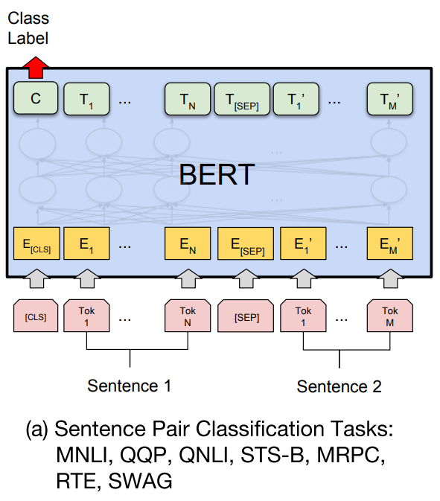
5. Fine-tuning BERT

Slide 39
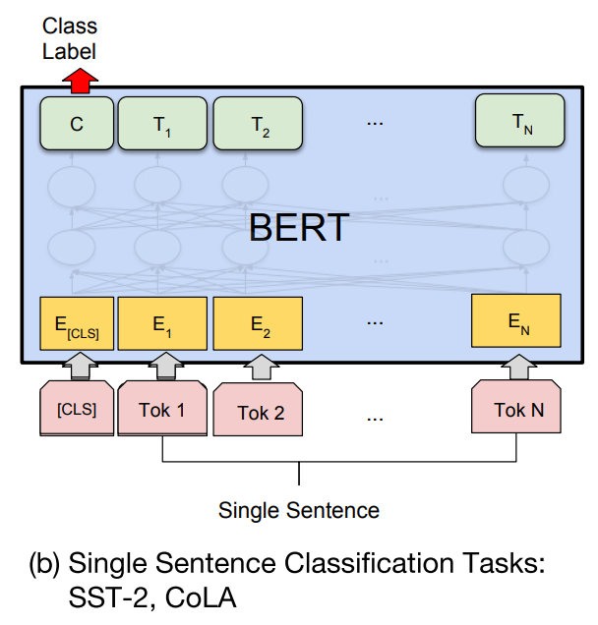
5. Fine-tuning BERT

Slide 40
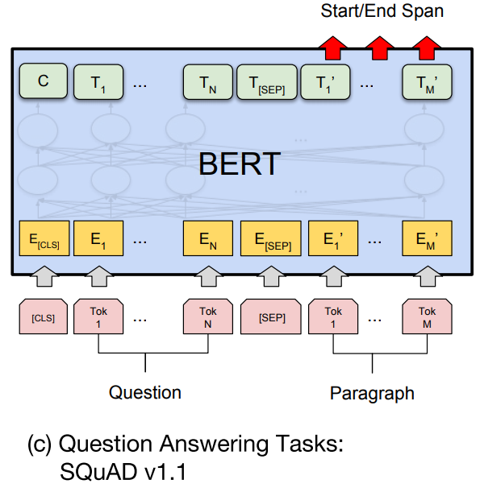
5. Fine-tuning BERT

Slide 41
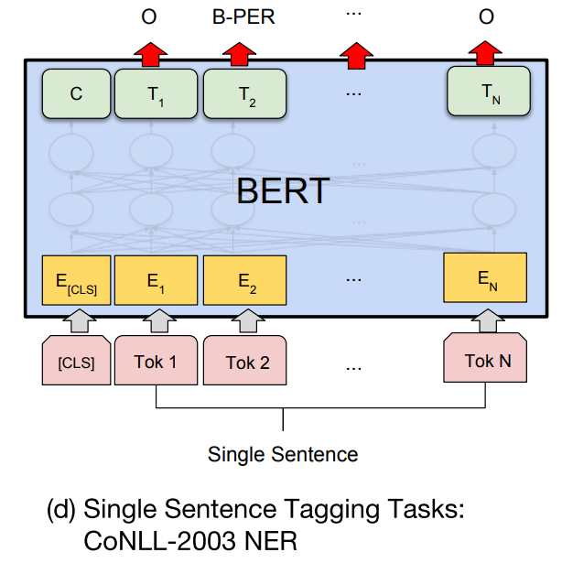
5. Fine-tuning BERT

Slide 42
6. References
[1] Introduction to Deep Learning for Natural Language Processing, Wikidocs
[2] Sennrich, R., Haddow, B., & Birch, A. (2015). Neural machine translation of rare words with subword units. arXiv preprint arXiv:1508.07909.
[3] Vaswani, A., Shazeer, N., Parmar, N., Uszkoreit, J., Jones, L., Gomez, A. N., ... & Polosukhin, I. (2017). Attention is all you need. In Advances in neural information processing systems (pp. 5998-6008).
[4] Devlin, J., Chang, M. W., Lee, K., & Toutanova, K. (2018). Bert: Pre-training of deep bidirectional transformers for language understanding. arXiv preprint arXiv:1810.04805.

